Slide 1
Smart Classroom System with Vision-Based Student Engagement Analysis
Using Convolutional Neural Networks (CNN)
Presented by: [Shaik ismail,Varshith Reddy ,Saurabah]

Slide 2
Problem Statement
Monitoring student engagement in classrooms is challenging.
Traditional methods are manual and time-consuming.
Need for an automated, AI-based solution.

Slide 3
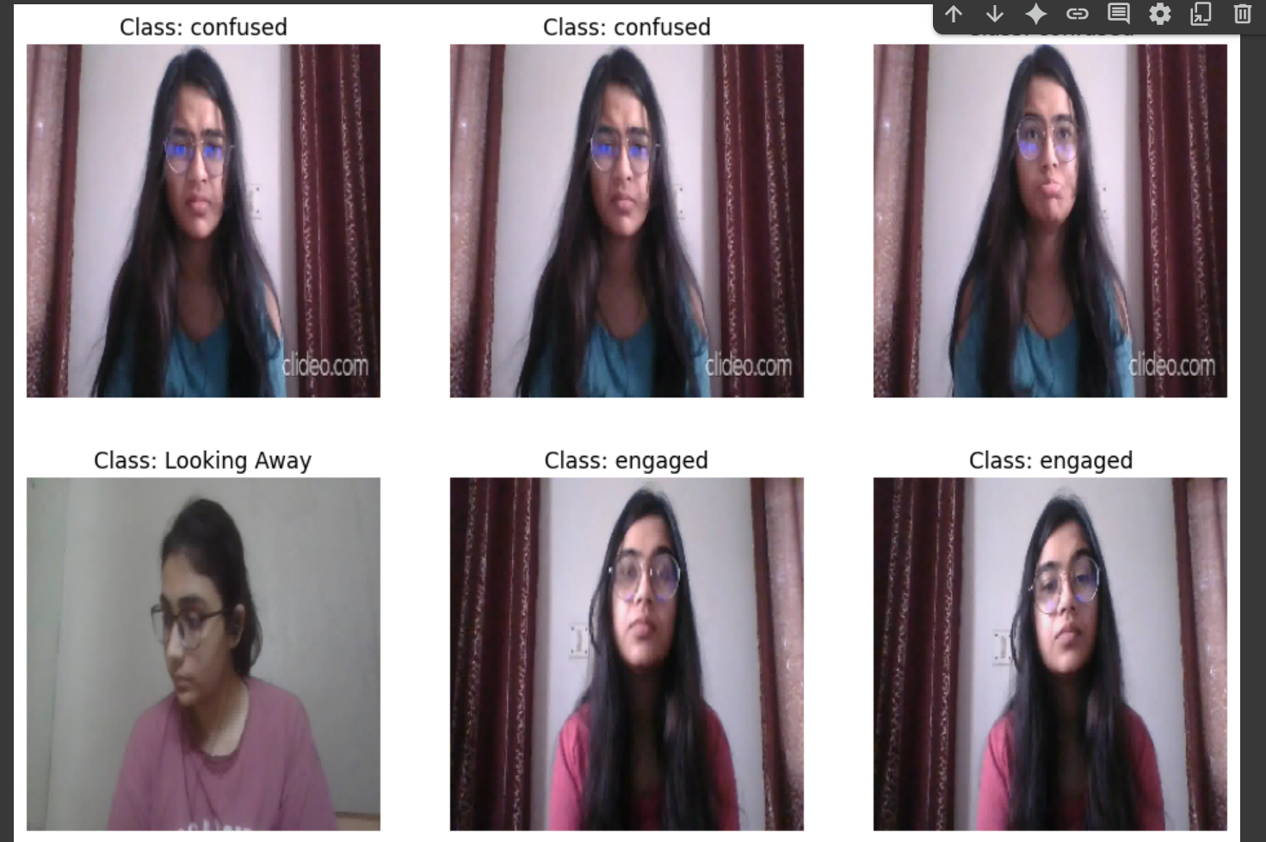
Objective
To classify students as Engaged or Not Engaged using facial image data and CNN-based classification.

Slide 4
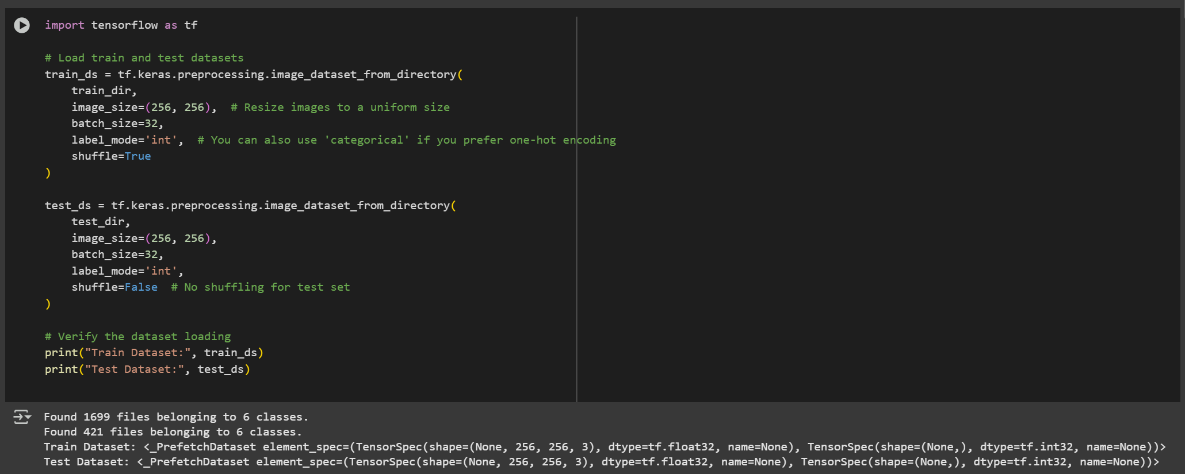
Dataset Overview
Images categorized into two classes: 'Engaged' and 'Not Engaged'.
Image size: 256x256 pixels.
Dataset split into training and validation sets (80/20).

Slide 5
Tools & Technologies
Python, TensorFlow, Keras
NumPy, Matplotlib, Sklearn
Google Colab or Jupyter Notebook

Slide 6
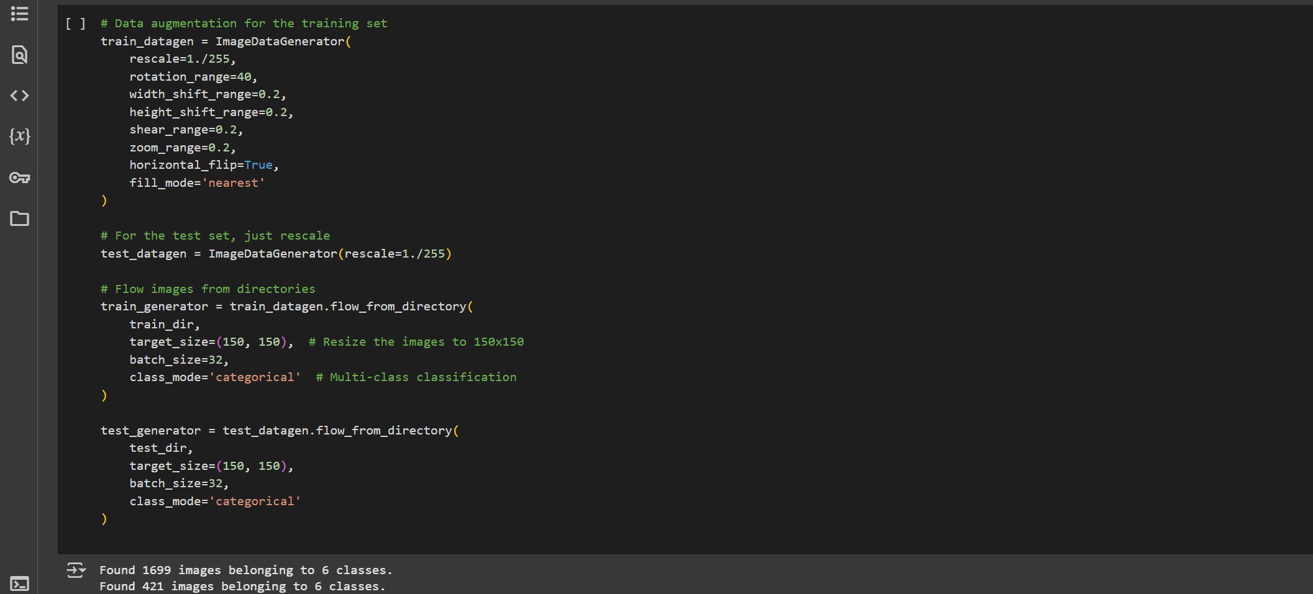
Data Preprocessing
Images loaded using ImageDataGenerator.
Rescaling pixel values (0–1).
Split into training and validation sets.

Slide 7
Model Architecture
1. Conv2D (32 filters, 3x3) + ReLU
2. MaxPooling2D (2x2)
3. Conv2D (64 filters, 3x3) + ReLU
4. MaxPooling2D (2x2)
5. Flatten
6. Dense (128 neurons, ReLU)
7. Dense (1 neuron, Sigmoid)

Slide 8
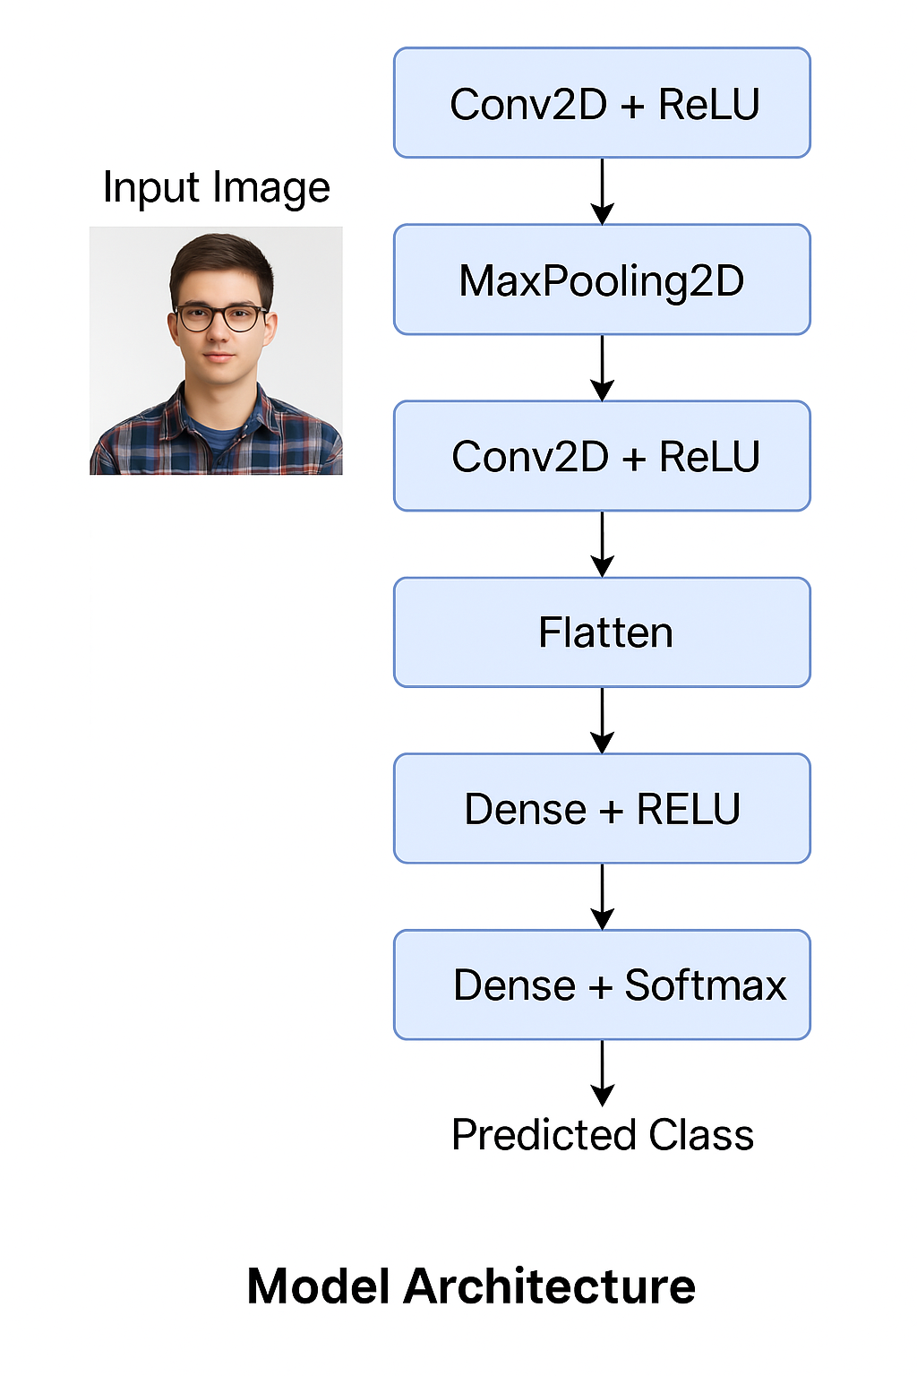
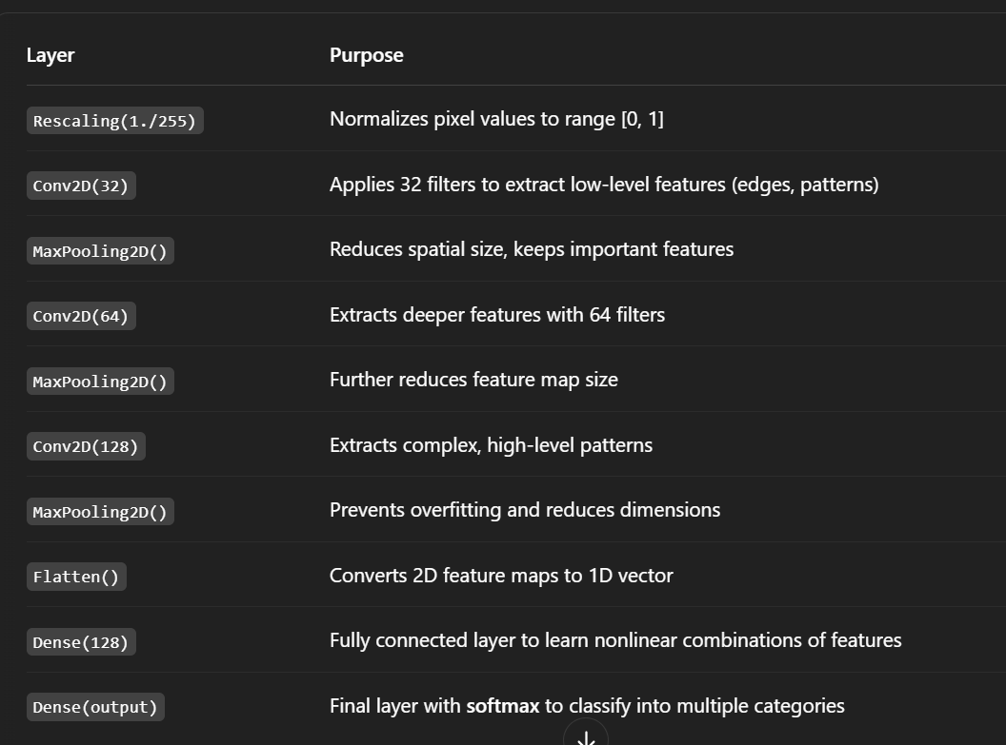
Uses of layers

Slide 9
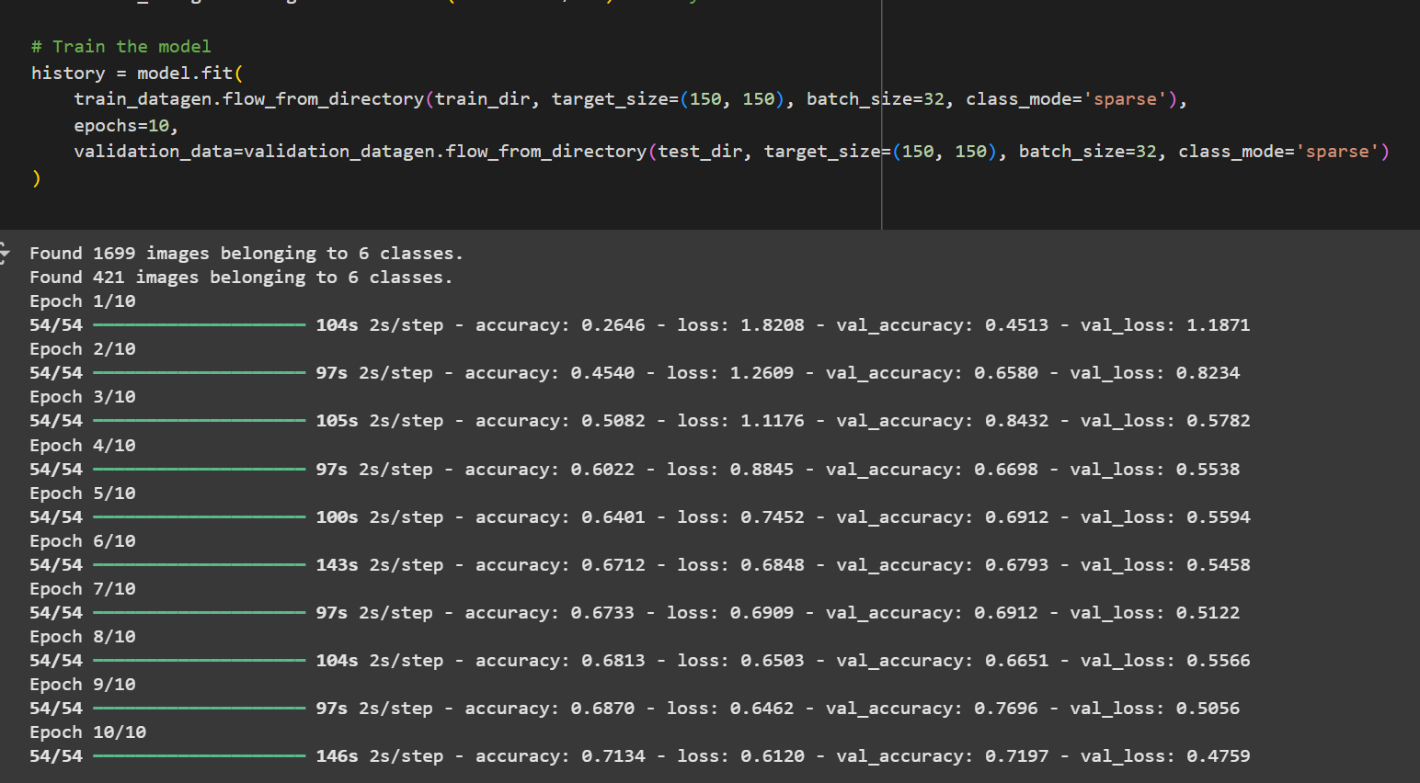
Model Training
Loss Function: Binary Crossentropy
Optimizer: Adam
Epochs: 10
Batch Size: 32

Slide 10
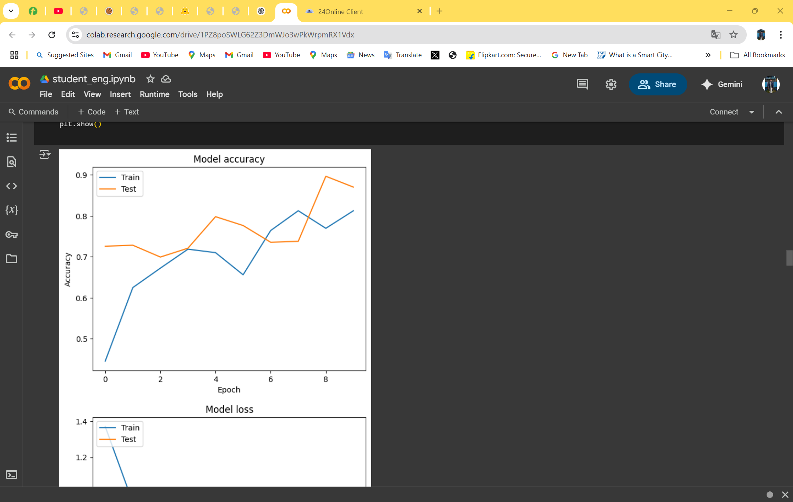
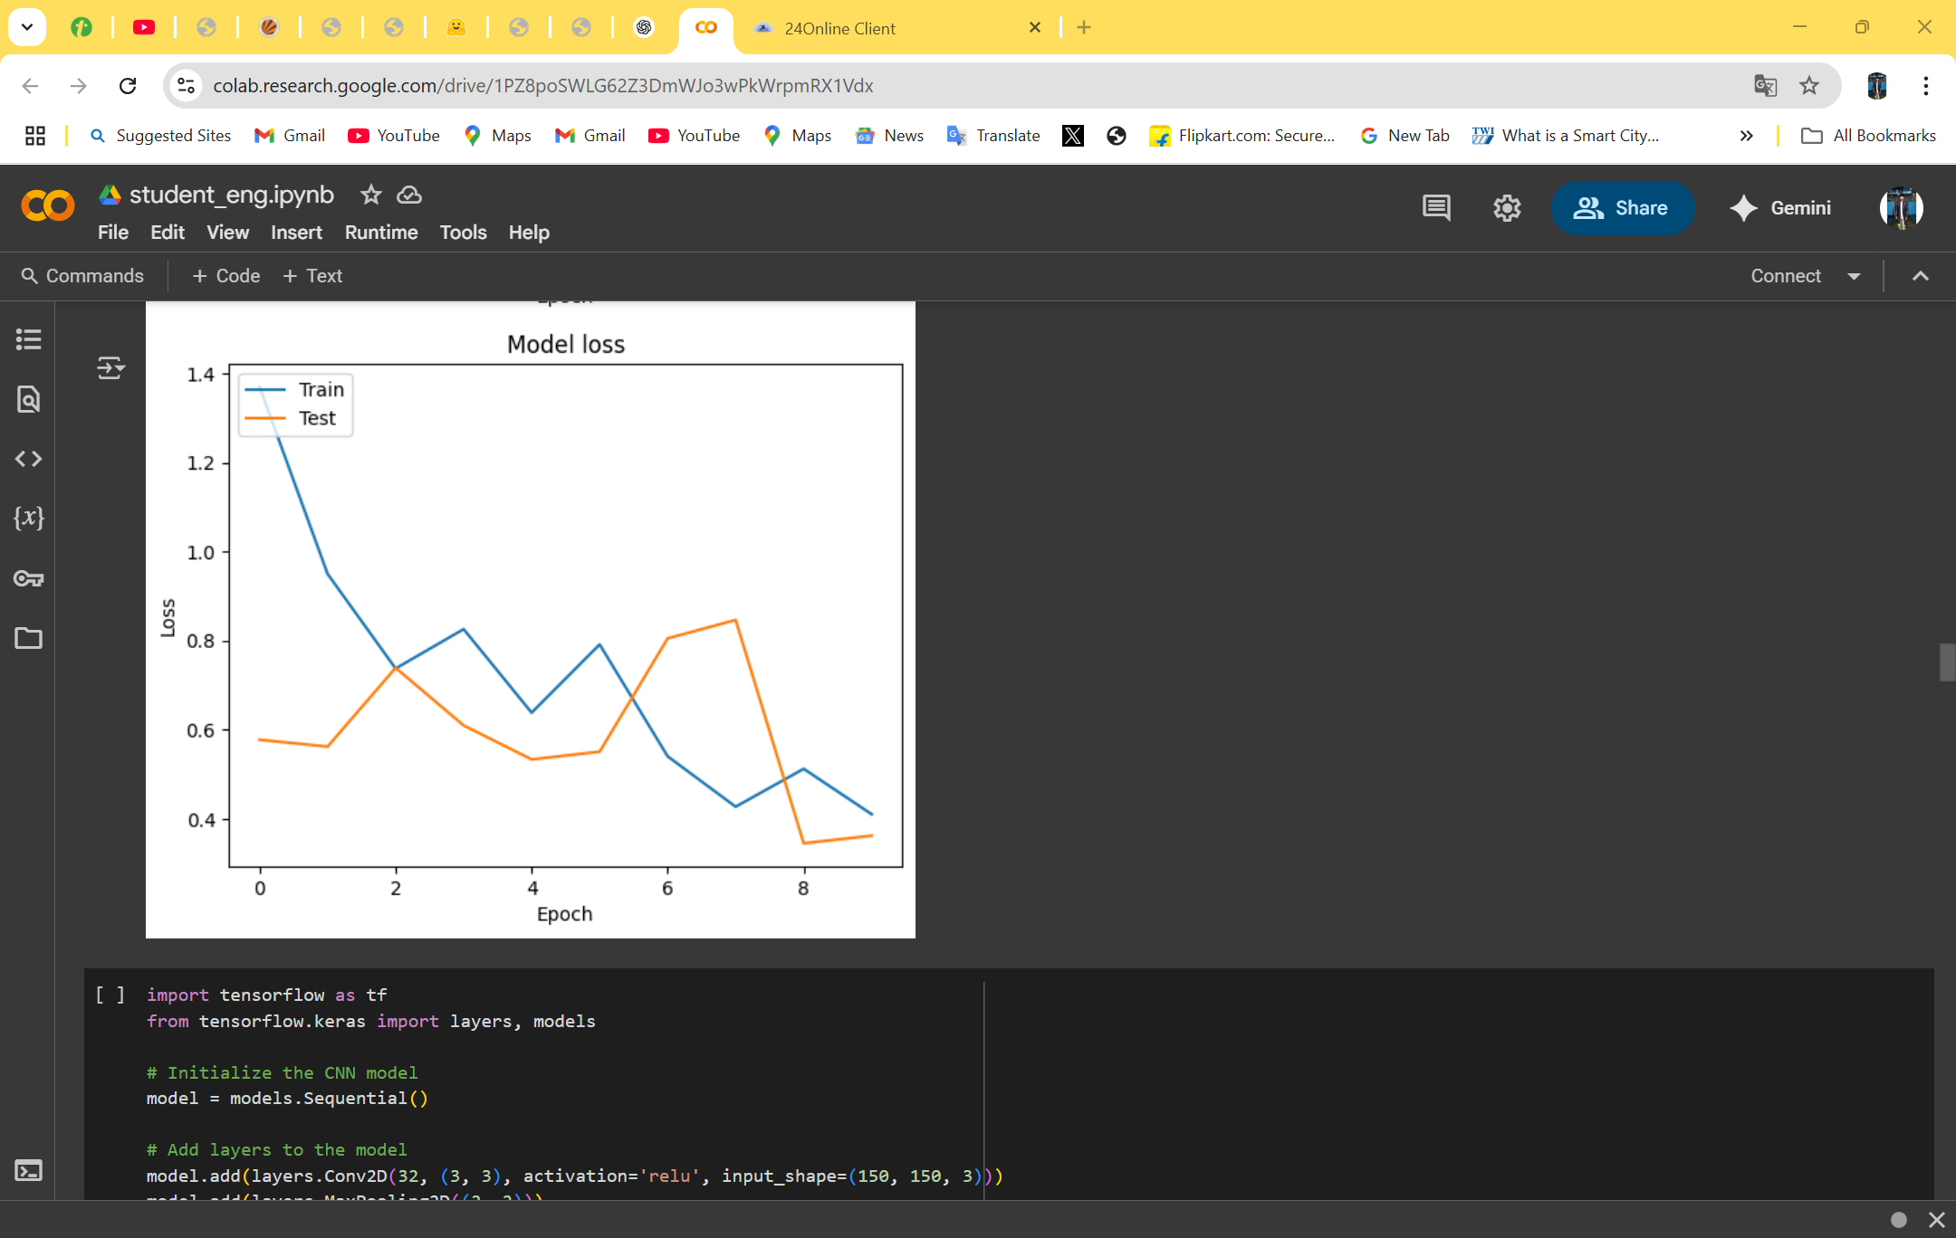
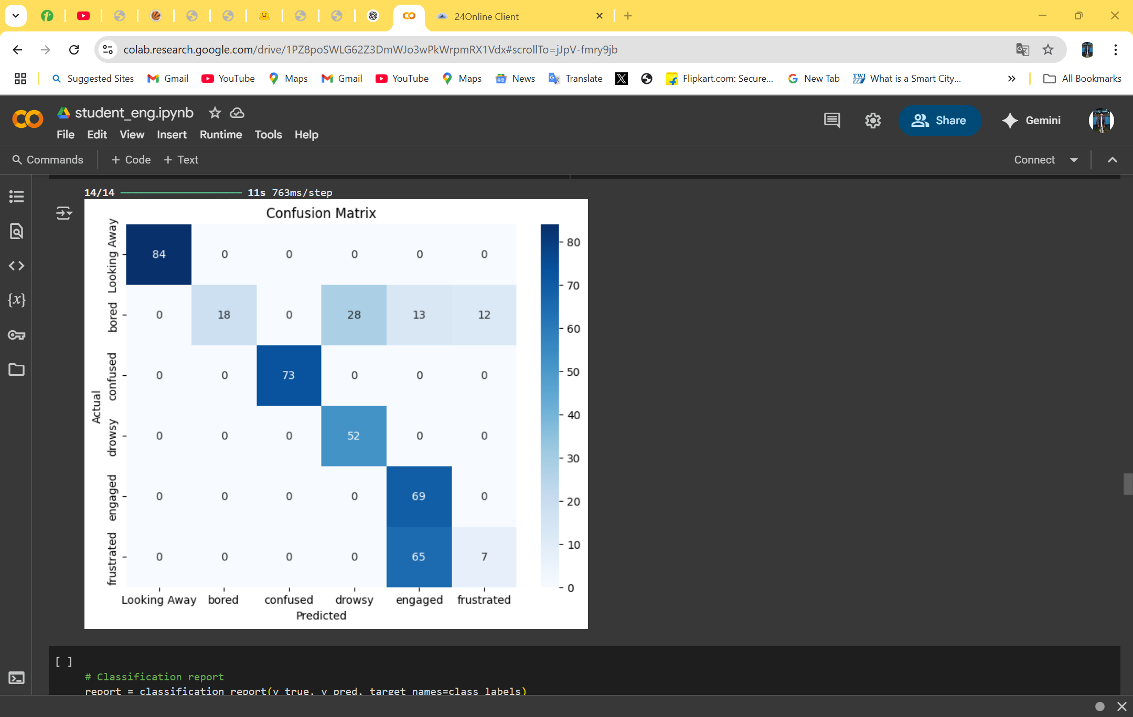
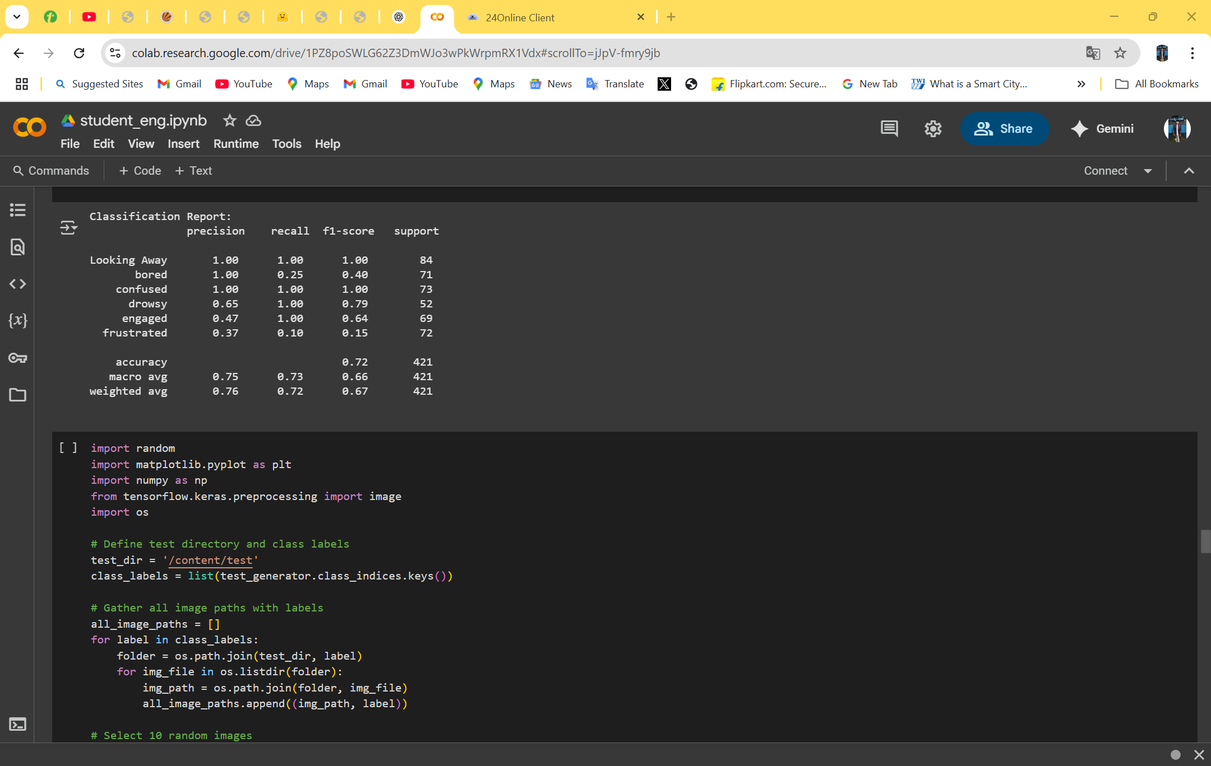
Model Evaluation
Accuracy and loss graphs plotted.
Confusion matrix and classification report generated.
Metrics: Precision, Recall, F1-score

Slide 11
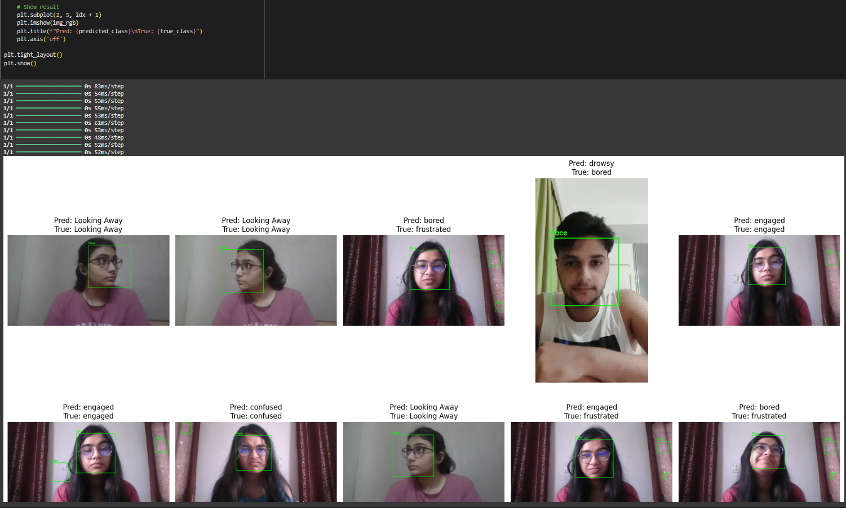
Results
Model shows good accuracy in classifying engagement.
Clear distinction between engaged and not engaged images.
Ready for real-time application with improvements.

Slide 12
Applications
Real-time classroom monitoring.
Online education platforms.
Interactive learning analytics systems.

Slide 13
Future Enhancements
Data augmentation techniques.
Transfer learning with MobileNet or VGG.
Real-time webcam integration using OpenCV.
Deployment using Flask or TensorFlow Lite.

Slide 14

Thank You All

